Slide 1

RESUME DOCUMENT:
HEADER: name ,city , E. mail ,user name
Summary: 2-3 lines about your career goal
Education: degree, school \ collage year
Experience: job \ internship, company, year 2-3 bullet point
Skills: list of key skills
Hobbies: just write 2-6 hobbies

Slide 2
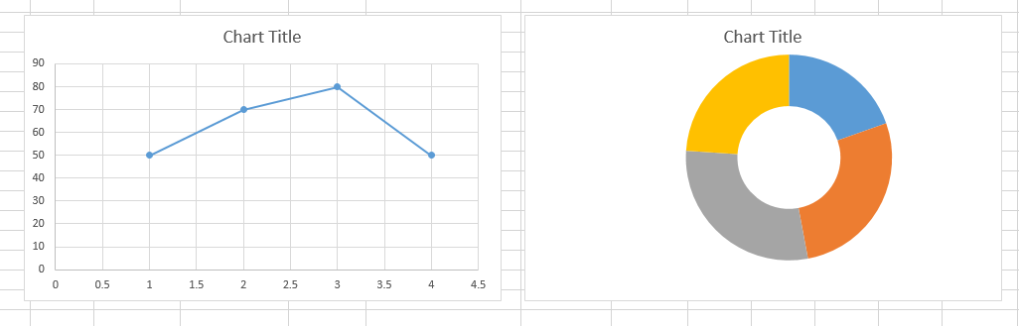
How to use the chart \ graph in excel:
Enter data
Select data
Go to insert ….>>chart
Choose chart type (column , line , pie )
Edit tities , labels , color.

Slide 3
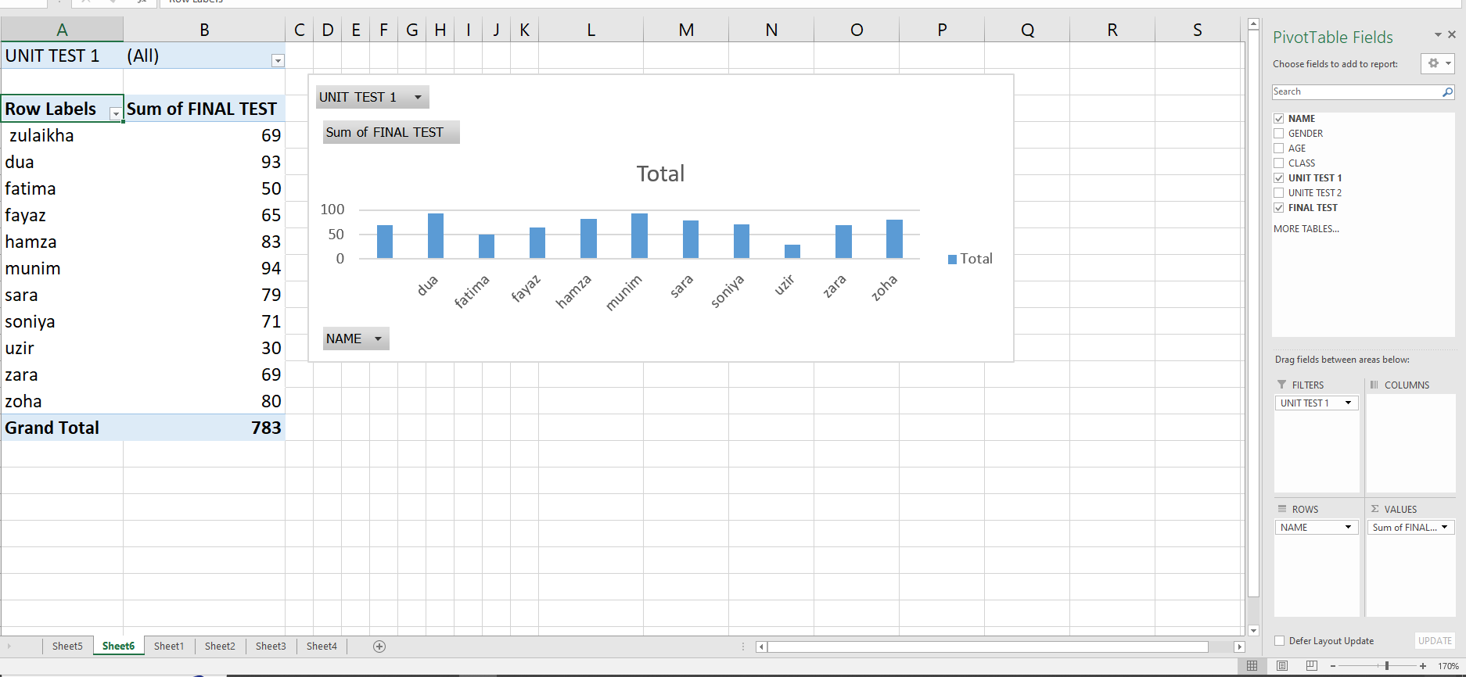
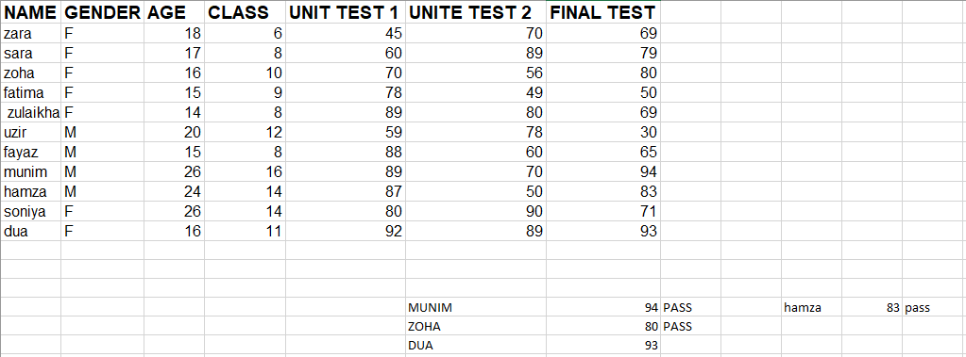
Pivot table:
select data …> insert …> pivot table
Drag fields to:
Row..>categories
Columns..>comparison
Values..>numbers(sum , average , count)
Filter..>filter data
“A pivot table is a tool in excel that quickly summarizes and analyzes
Large data into rows , columns , and values”.

Slide 4
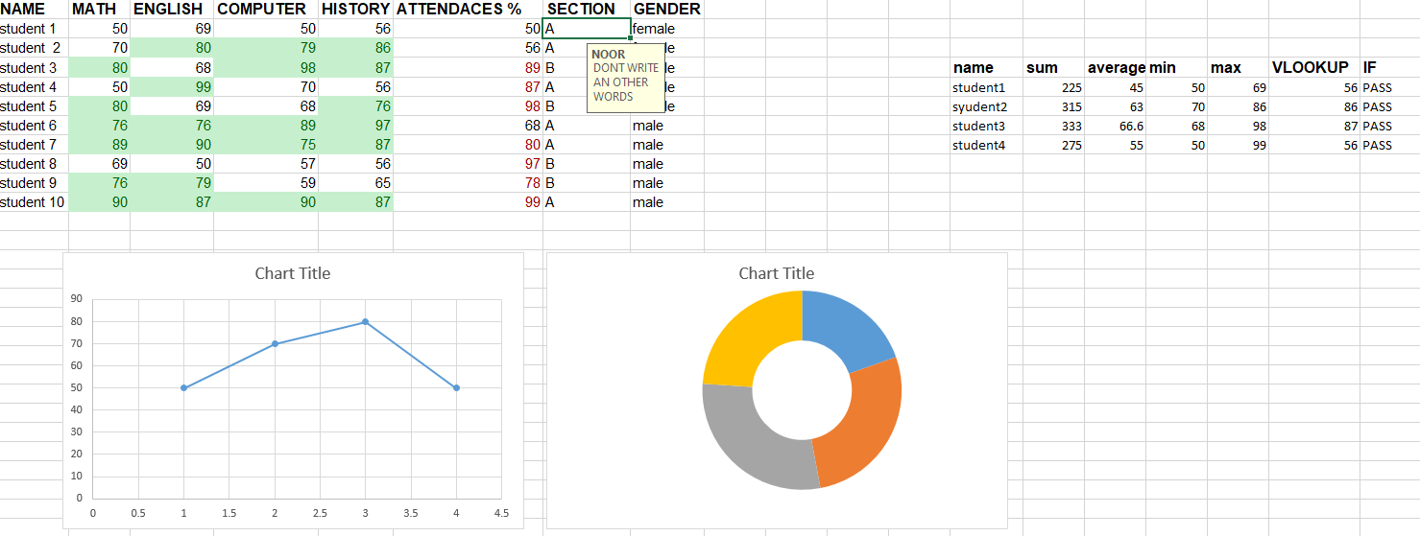
Spreadsheet:
It contain students marks in subjects (math , English , computer , history) and attendance
Chart:
Line chart …>show performance trend of student
Donut chart...>show marks distribution
Calculation:
Sum …>total mark of each student
Average …> average marks
Max…> highest marks
V look up …>use to quickly find specific students data
“Able to create spreadsheet with charts formulas
(sum , average , max , min )and function
like v look up for data analysis”.
Data validation:
Apply …> select cell …> data …>data validation …> set rule
( number , date , list )
use…> make dropdowns , restricts wrong , entries
important …>keeps data accurate and consistent.
“Able to use data validation in excel for accurate data entry”
Conditional formatting:
conditional formatting in excel highlights cells automatically based on rules
( color marks below s50 in red or green)

Slide 5
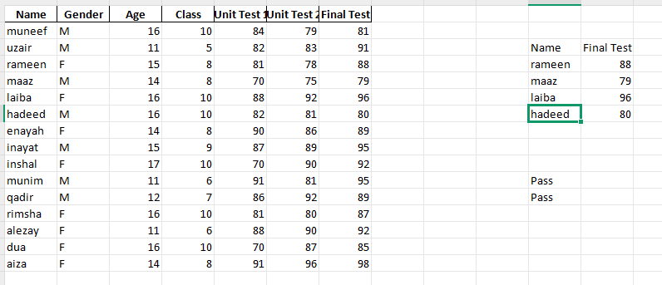
Student record:
What is it: a table showing student details (name , gender ,age , class)and marks ( unit tests , final test)
Why important : keeps results organized , easy to track performance, compare students , and check pass\fail
Benefits : saves time , reduces errors, helps in analysis
How made: enter data in excel …> add columns for tests …> use formulas (sum , average , if , v look up ) for results
“A student record sheets in excel organizes marks and details for easy tracking and
Analysis.”

